Slide 1
Agile Engineering Practices
Joseph Cutrono

Slide 2
Agile Engineering
Individuals and interactions over processes and tools
Working software over comprehensive documentation
Customer collaboration over contract negotiation
Responding to change over following a plan

Slide 3
Agenda
Gitflow 101
Testing a story
Continuous Integration
Continuous Delivery

Slide 4
Gitflow
Manages multiple dev features in progress
Branching lets dev features stay up to date with current development
Supports keeping code base clean for deployment

Slide 5
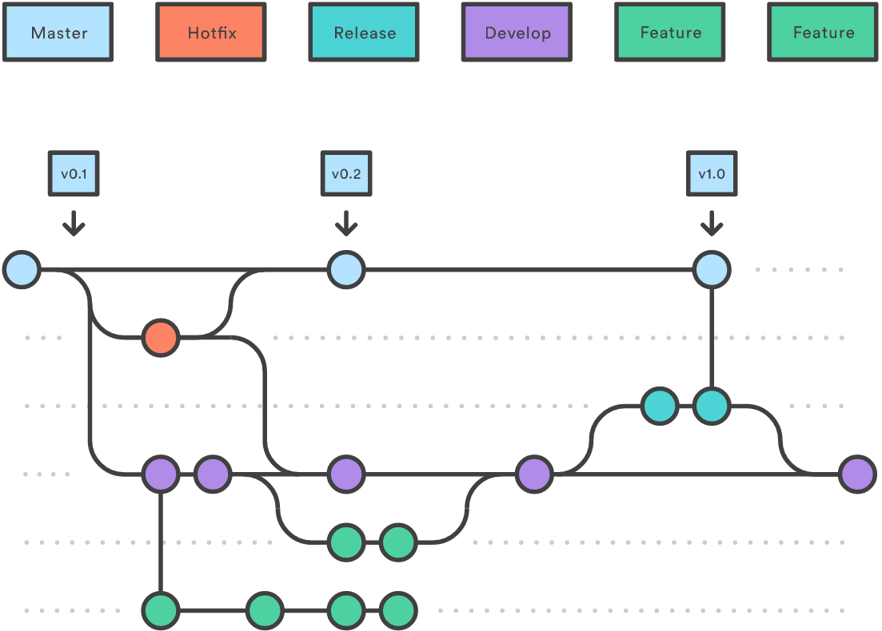




Slide 6
Testing

Slide 7

Collaboration
Development
Testing

Slide 8
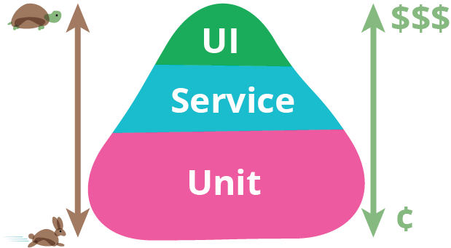
Testing Pyramid
Development
Testing
* http://martinfowler.com/bliki/TestPyramid.html

Slide 9
Warning Signs
TODO | Development | Testing | DONE
STORY
STORY
STORY
STORY
STORY
STORY
STORY
STORY
STORY
STORY
STORY
STORY
STORY

Slide 10
Simplest Board
TODO | DOING | DONE
STORY
STORY
STORY
STORY
STORY
STORY
STORY
STORY
STORY
STORY
STORY
STORY
STORY

Slide 11



Continuous Integration

Slide 12
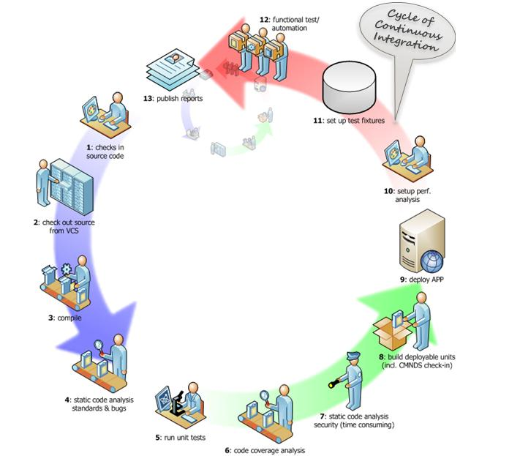

Slide 13
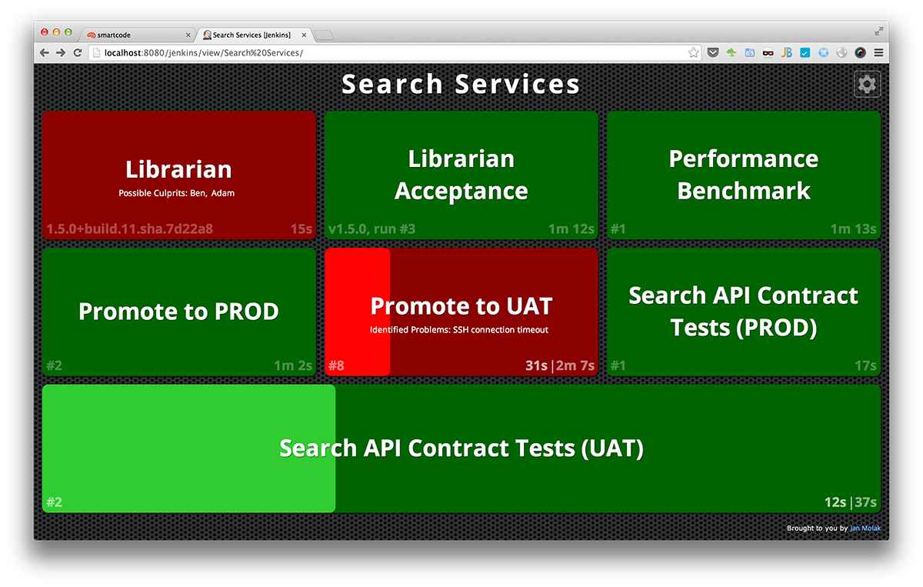
Build Monitor

Slide 14
CONTINUOUS DELIVERY

Slide 15
Rapid feedback needs rapid deployment
Automated – Very little/No human intervention
Code is only escalated once it passes test automation
Build Monitor
Continuous Delivery

Slide 16
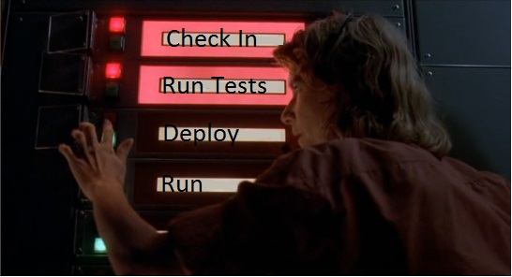
Push Button

Slide 17


Slide 18
https://github.com/jcutrono/leanagileus

Slide 20
POWERPOINT TEMPLATE HELPFUL TIPS
COLORS PALETTE
STANDARD COLORS for all graphics and charts
ADDITIONAL TIPS
PRIMARY COLORS
SECONDARY COLORS
ACCENT COLORS
SLIDE TRANSITIONS
For consistency, please keep all slides’ “FADE” transition.
R80 G158 B47
R99 G102 B106
R17 G94 B103
R0 G59 B92
R206 G217 B229
R237 G139 B0
R206 G220 B0
R122 G65 B131
COMPANY LOGOS
In inserting company logos, please use a white background.
*Select SHAPE FILL (or SHAPE OUTLINE) > MORE COLORS > SELECT RGB COLOR CODES
FONT
FONT COLOR on white or light background
FONT COLOR on dark background
R66 G66 B66
R255 G255 B255
FONT STYLE AND SIZE
APPLICATION FOR TESTIMONIALS AND ORGANIZATION CHARTS
SLIDE TITLES
STYLE: Century Gothic - Bold; Uppercase
SIZE: As best practice, minimum content size works ideally at 36 points
CONTENT
STYLE: Century Gothic - Regular; Sentence Case
SIZE: As best practice, minimum content size works ideally at 18 points.
PERSON’S NAME
STYLE: Century Gothic - Bold; Uppercase
SIZE: As best practice, minimum size works ideally at 18 points
PERSON’S TITLE/ ORGANIZATION
STYLE: Century Gothic - Regular; Sentence Case
SIZE: As best practice, minimum size works ideally at 18 points
*Select FONT COLOR > MORE COLORS > SELECT RGB COLOR CODES

Slide 21






















Slide 22

























